Slide 1

PLDs, CPLDs and FPGAs
Winter 1400 (Computer Aided Design)
Meisam Abdollahi
School of Computer Engineering
Iran University of Science and Technology
meisam.abdolahi@ut.ac.ir

Slide 2
Outline
History of Programmable Logic Devices
Programming Technology
Programmable Logic Array (PLA)
Read Only Memory (ROM)
Programmable Array Logic (PAL)
Generic PAL (GAL)
Complex PLDs (CPLD)

Slide 3
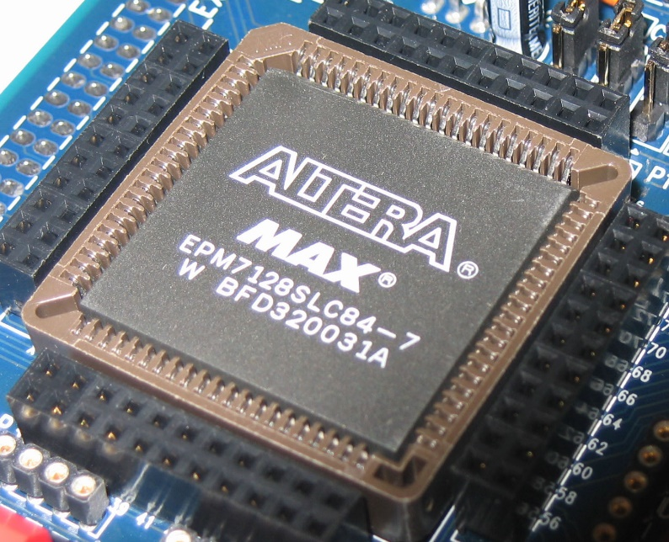
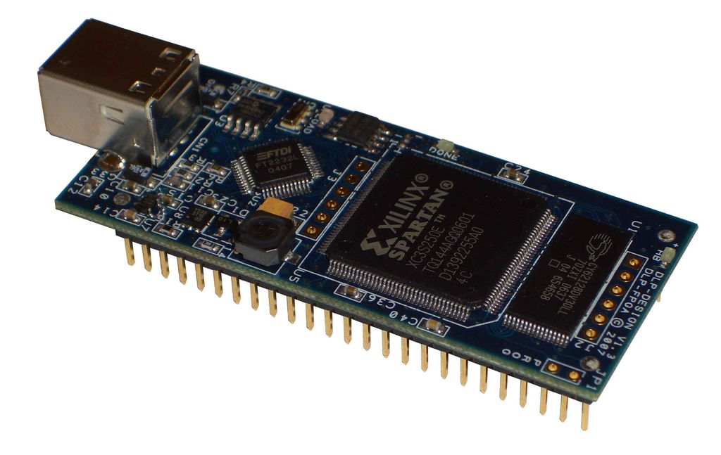
History of Programmable Logic Devices

Slide 4
History of PLDs (I)
Programmable Logic Devices (PLDs) were introduced in the mid 1970s.
The idea was to construct combinational logic circuits that were programmable.
A PLD is a general purpose chip whose hardware can be reconfigured to meat particular specifications.
The first PLDs were called PAL (Programmable Array Logic) or PLA (Programmable Logic Array), depending on the programming scheme
They used only logic gates (no flip-flops), thus allowing only the implementation of combinational circuits.
Registered PLDs were launched later, which included one flip-flop at each output of the circuit
Simple sequential functions could then be implemented as well.

Slide 5
History of PLDs (II)
In the beginning of the 1980s, additional logic circuitry was added to each PLD output.
The new output cell, called Macrocell, contained (besides the flip-flop) logic gates and multiplexers.
It provided a ‘return’ (feedback) signal from the output of the circuit to the programmable array
This new PLD structure was called generic PAL (GAL).
All these chips (PAL, PLA, registered PLD, and GAL) are now collectively referred to as SPLDs (Simple PLDs).

Slide 6
History of PLDs (III)
Later, several GAL devices were fabricated on the same chip, using a more sophisticated routing scheme, more advanced silicon technology, and several additional features
This approach became known as CPLD (Complex PLD).
CPLDs are currently very popular due to their high density, high performance, and low cost
Finally, in the mid 1980s, FPGAs (Field Programmable Gate Arrays) were introduced.
FPGAs differ from CPLDs in architecture, technology, built-in features, and cost.

Slide 7
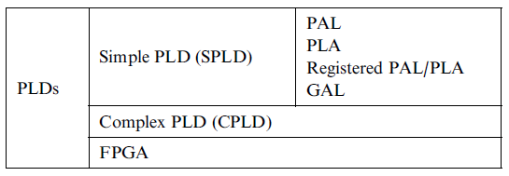
Different Types of PLDs
All PLDs (simple or complex) are non-volatile. They can be OTP
(one-time programmable), in which case fuses or anti-fuses are used, or can be reprogrammable, with EEPROM or Flash memory
FPGAs, on the other hand, are mostly volatile, for they make use of SRAM to store the connections, in which case a configuration ROM is necessary to load the interconnects at power up

Slide 8
Programming Technology

Slide 9
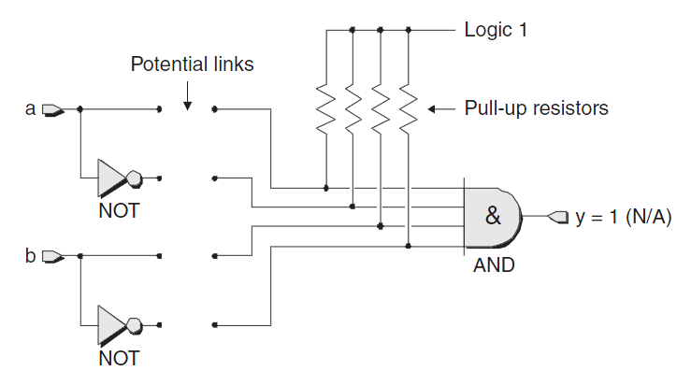
A potential programmed device
Make a link between two points (Potential links) means program the device

Slide 10
Programming Technologies
Some of the well known programming technologies include
Fusible link technology
Anti-fuse
Static Memory (SRAM)
EPROM, E²PROM and Flash

Slide 11
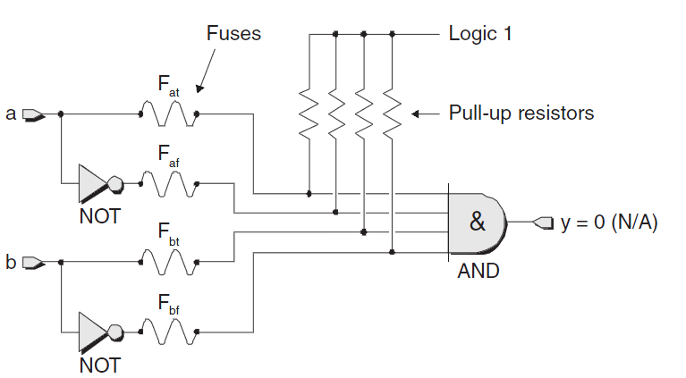
Fusible Link Technologies (I)
One of the first techniques, fusible-link technology
All of the fuses are initially intact (after manufacturing).
Design engineers selectively remove undesired fuses by applying pulses of relatively high voltage and current to the device’s inputs.
These devices are one-time programmable (OTP), and are not used in FPGAs.
Blowup fuses

Slide 12
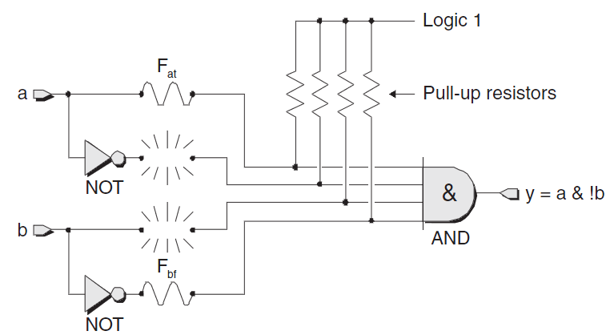
Fusible Link Technologies (II)
Blowup fuses

Slide 13
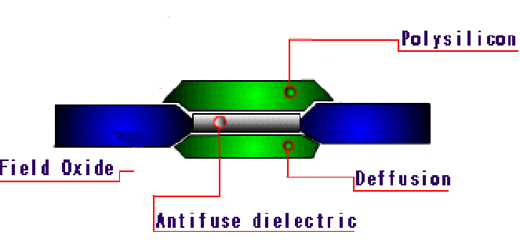
Anti-fuse Programming Technology (I)
Contrary to a fuse, an anti-fuse is normally an open circuit.
Anti-fuses locate at each connection customization point.
The two-terminal elements are connected to the upper and lower layer of the anti-fuse, in the middle of which a dielectric is placed
In the initial state, the high resistance of the dielectric does not allow any current to flow between the two layers.
Applying a high voltage causes large power dissipation in a small area, which melts the dielectric
This operation drastically reduces the resistance and a link can be built, which permanently connects the two layers.
Type of dielectric: Oxygen-Nitrogen-Oxygen (ONO)
(Substrate)

Slide 14
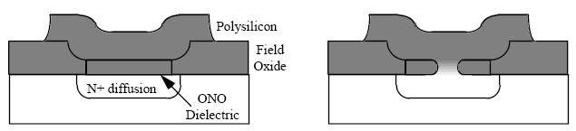
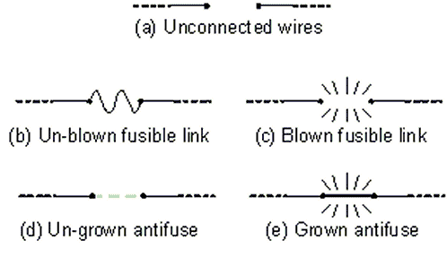
Anti-fuse Programming Technology (II)

Slide 15
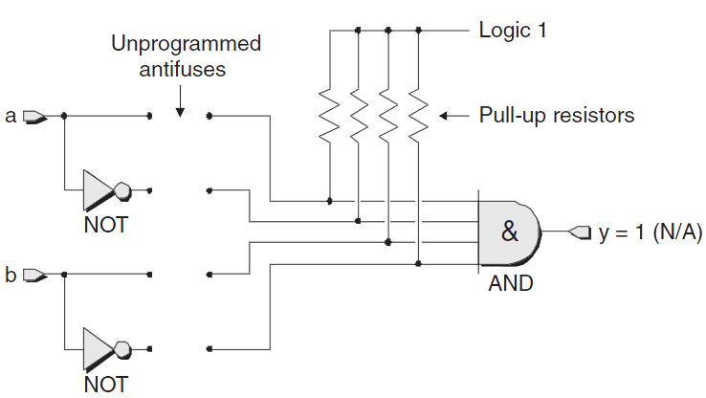
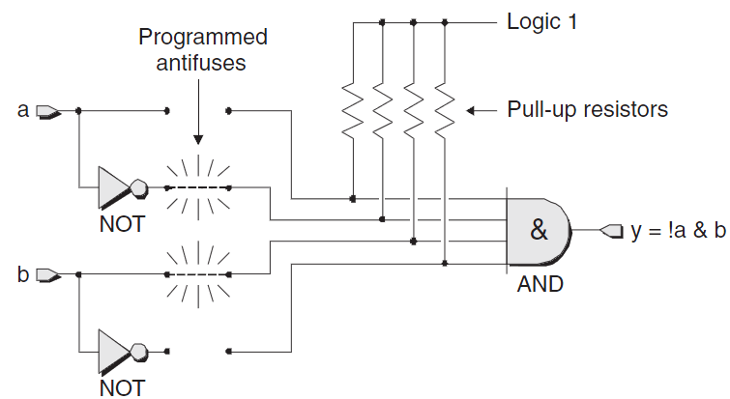
Anti-fuse Programming Technology (III)

Slide 16
Anti-fuse Programming Technology (II)
Anti-fuse Technology:
Advantages:
It needs low area
This technology is non-volatile in nature [no need to external ROM]
High reliability [40 years]
Low capacitor parasites
High security against forgery and IC pirate
Low power cost
Drawbacks:
Anti-fuse programming technology based devices can not be reprogrammed
Its programming needs an external circuit [it needs high voltage and current]

Slide 17
Mask-programmed devices
Basic ROMs (non-volatile read-only memory as opposed to RAM which are read-write and volatile) are mask-programmable.
Data in ROMs is hard-coded, using photo-masks that define the metallization structure (and connectivity)
The entire ROM consists of a number of row (word) and column (data) lines forming an array.
Each column has a single pull-up resistor attempting to hold that column to a weak logic 1.
Every row-column intersection has an associate transistor and potentially a mask-program connection.

Slide 18
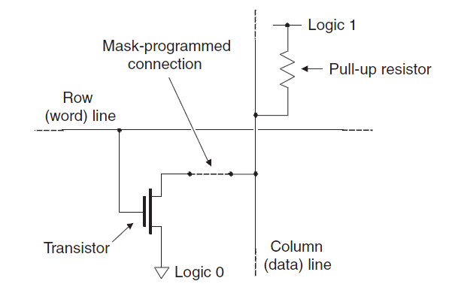
A Transistor-based Mask-program ROM Cell

Slide 19
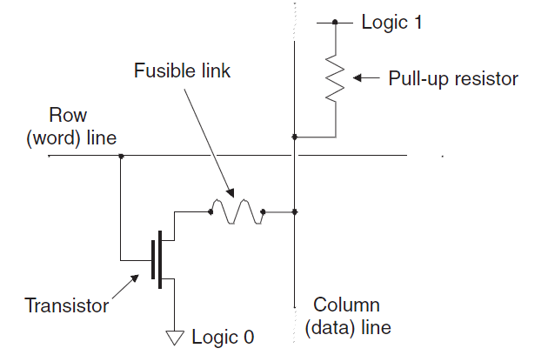
Programmable ROM (PROM)
Problems with Mask-Programmed:
Very expensive due to mask process (unless in large quantities)
Time consuming process
PROMs are based on fusible technology and transistor based

Slide 20
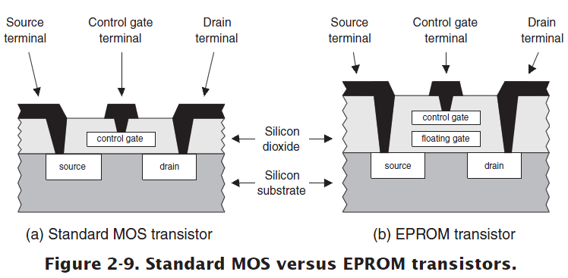
EPROM Programming Technology (I)
Erasable programmable read only memory (EPROM) devices are based on a floating gate
The device can be permanently programmed by applying a high voltage (10–21 V) between the control gate and the drain of the transistor (12 V).
This causes the floating gate to be permanently and negatively charged.
This negative potential on the floating gate keeps the transistor closed
In an ultra violet (UV) PROM, the programming process can be reversed by exposing the floating gate to UV-light
For this purpose, the device must be removed from the system in which it operates and plug into a special device.

Slide 21
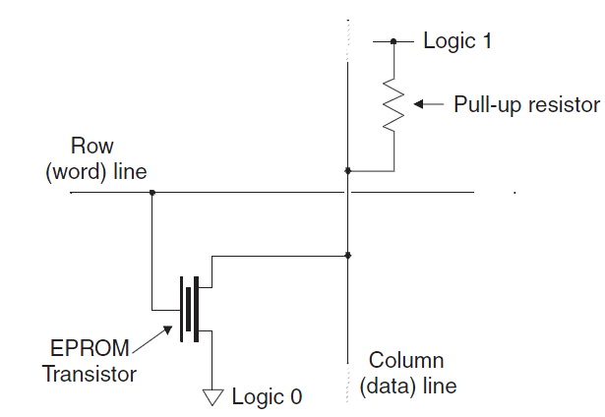
An EPROM transistor-based Cell

Slide 22
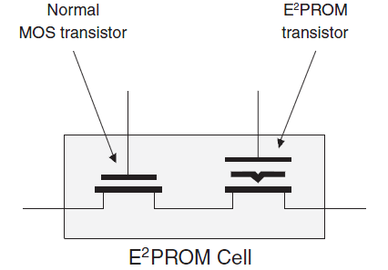
EPROM Programming Technology (II)
In electrically erasable and programmable ROM (EEPROMs) and in flash-EPROM, the erase operation is accomplished electrically, rather than by exposure to ultraviolet light.
To erase the floating gate: A high negative voltage must therefore be applied at the control gate
This process is faster than using a UV lamp, and the chip does not have to be removed from the system
In EEPROM-based devices, two transistors are typically used in a ROM cell: one access and one programmed transistor.
The programmed transistor performs the same function as the floating gate in an EPROM.

Slide 23
EPROM Programming Technology (III)
Advantages:
This programming technology is nonvolatile in nature [no need to external ROM]
More area efficient than SRAM-based programming technology
Drawbacks:
It can not be reconfigured/reprogrammed an infinite number of times
The negative charges can be accumulated slowly under the floating gate
Reprogramming is not easy
High impedance when transistor is on

Slide 24
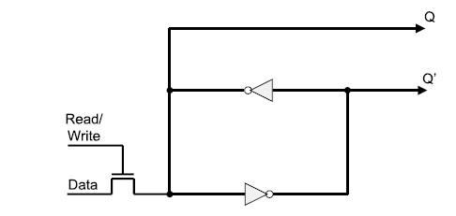
SRAM Programming Technology (I)
Anti-fuse is used mostly to configure the connections.
SRAM is use to configure the logic blocks and the connection as well.
The functionality of logic blocks and connections is controlled using the output of the SRAM cell
The standard SRAM cell is composed of two cross-coupled inverters and uses a standard CMOS-process
The Q-output is connected to the module, e.g., selector of multiplexer
The read-and-write word line: To read or to write
data from or to the SRAM through the data line
Xilinx SRAM Cell

Slide 25
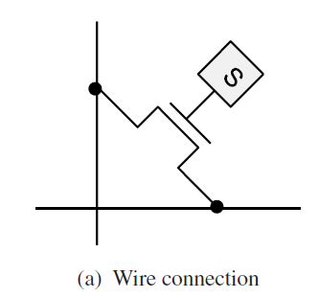
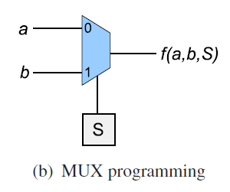
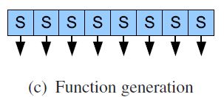
SRAM Programming Technology (II)
A connection between two wires can be done by a pass transistor connected to the wires
The selector input of a multiplexer can be a SRAM cell
The content of a look-up table can be reprogrammed by just copying new values into the corresponding SRAM cells

Slide 26
SRAM Programming Technology (III)
Static memory (SRAM)
Advantages:
FPGA can be easily re-programmed
can be programmed (configured) indefinitely
the device can be done in-circuit very quickly and allow the reconfiguration to be done on the fly.
Easy prototyping
The manufacture of FPGA can test it easily by reprogramming all paths [User can take a full-tested FPGA IC]
Main Drawbacks:
An SRAM cell requires 6 transistors which makes the use of this technology costly in terms of area
SRAM cells are volatile in nature and external devices are required to permanently store the configuration data
Low security against forgery and IC pirate
High power consumption

Slide 27
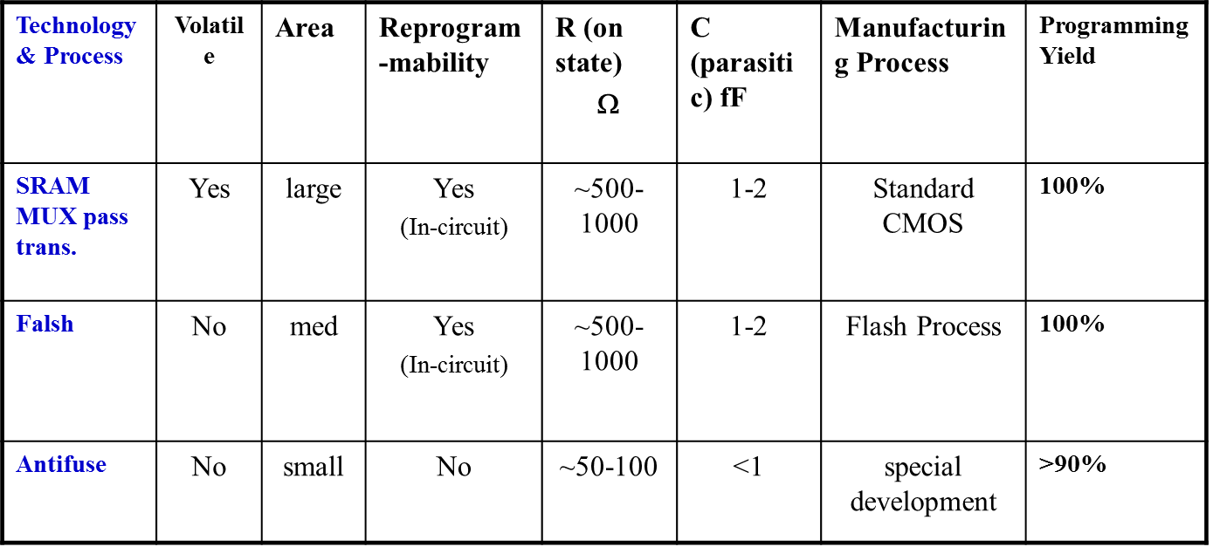
Programming Technology summary

Slide 28
The Structure of Programmable Logic Device

Slide 29
Programmable Logic Devices (I)
Simple Programmable Logic Devices (SPLD) are IC chips with internal logic gates connected by electronic fuses.
These fuses can be ‘blown’ (by programming) to obtain different circuit configurations.
Three classes of PLDs are :
Programmable Logic Array (PLA)
Programmable Read Only Memory (PROM)
Programmable Array Logic (PAL)

Slide 30
Programmable Logic Device (II)
PROM
PAL
PLA
Fixed
AND array
(Decoder)
Programmable
OR array
Inputs
Outputs
Programmable
AND array
Fixed
OR array
Inputs
Outputs
Programmable
AND array
Programmable
OR array
Inputs
Outputs

Slide 31
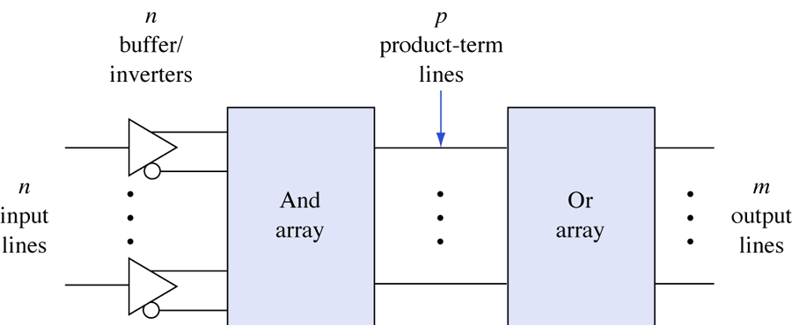
General structure of PLDs.

Slide 32
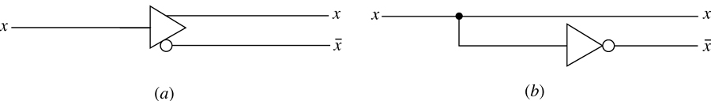
Buffer/inverter
(a) Symbol. (b) Logic equivalent.

Slide 33
Programmable Logic Devices (IV)
“Programming” an array – blowing the fuses.
A
A'
B
B'
A
A'
B
B'
x₁
x₁ = A.B
x₂
x₂ = A'.B
x₃
x₃ = A.B'
(a) Unprogrammed
(b) Programmed
Example of a basic AND array

Slide 34
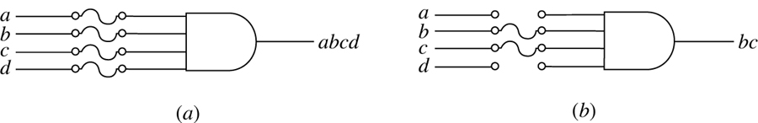
Programming by blowing fuses
(a) Before programming. (b) After programming.

Slide 35
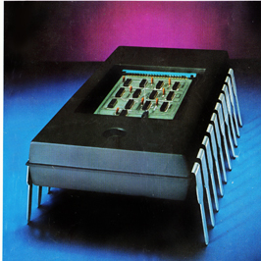
Programmable Logic Array (PLA)

Slide 36
PLA: programmable logic array
PLA (Programmable Logic Array) chips were also introduced in the mid 1970s
The combination of a programmable AND array followed by a programmable OR array is commonly referred to as a programmable logic array (PLA)

Slide 37
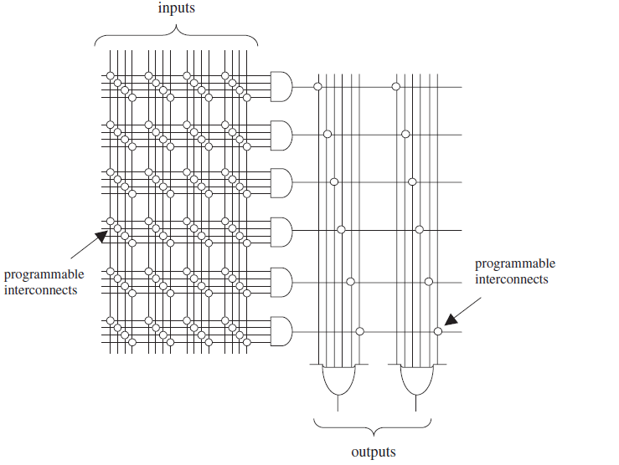
PLA Structure

Slide 38
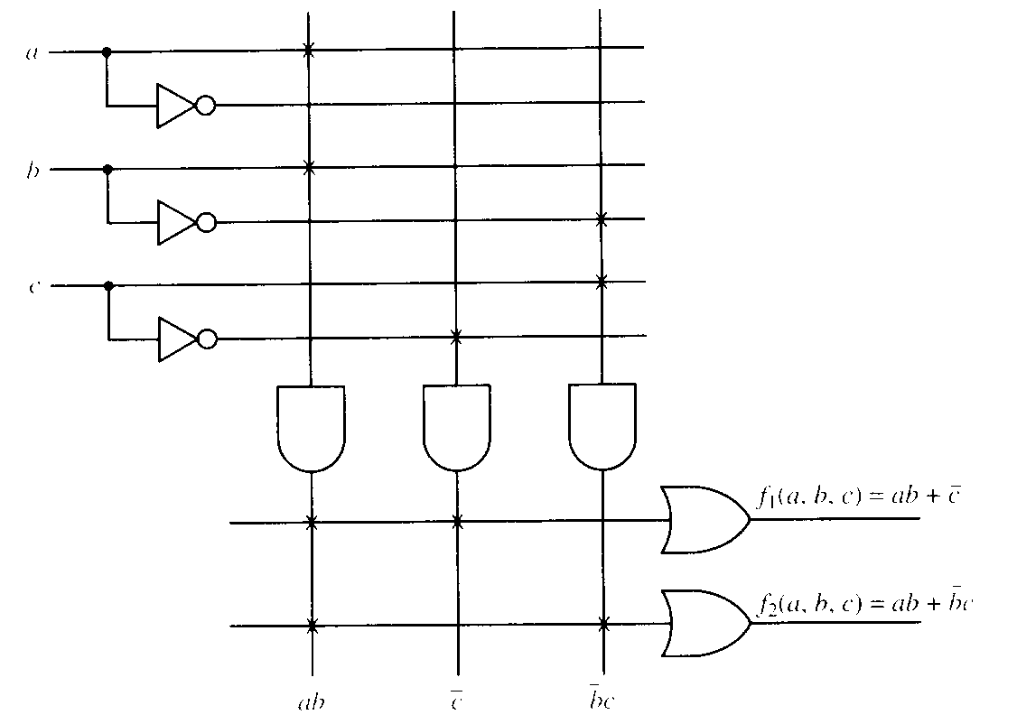
Circuit implementation with PLA
f₁(a,b,c) = ab + c
f₂(a,b,c) = ab + bc

Slide 39
PLA: More Examples
Combination of a programmable AND array followed by a programmable OR array.
Example: Design a PLA to realise the following three logic functions and show the internal connections.
f₁(A,B,C,D,E) = A’.B’.D’ + B’.C’.D + A’.B.C.D.E’
f₂(A,B,C,D,E) = A’.B.E + B’.C’.D.E
f₃(A,B,C,D,E) = A'.B'.D' + B'.C'.D'.E + A'.B.C.D

Slide 40
PLA: More Examples
f₁(A,B,C,D,E) = A'.B'.D' + B'.C.D' + A'.B.C.D.E'
f₂(A,B,C,D,E) = A'.B.E + B'.C.D'.E
f₃(A,B,C,D,E) = A'.B'.D' + B'.C'.D'.E + A'.B.C.D
A
X
X
X
X
B
X
X
X
X
X
X
X
C
X
X
X
X
Programmable AND array
X
D
X
X
X
X
X
X
E
X
X
X
X
A'.B'.D'
B'.C.D'
A'.B.C.D.E'
Programmable OR array
X
X
X
f₁
f₂
f₃
X
X
X
X
X
P₁
P₂
P₃
P₄
P₅
P₆
P₇
A'B'D'
A'BCDE'
B'CD'E
A'BCD
B'CD'
A'BE
B'C'D'E

Slide 41
PLA: Examples
A
B
C
Example:
F₁ = A B + AC + A B C
F₂ = (AC + BC)

Slide 42
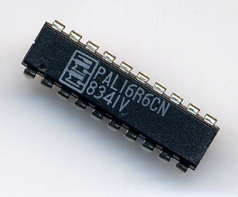
Programmable Array Logic

Slide 43
Programmable Array Logic (PAL)
PAL (Programmable Array Logic) chips were introduced by Monolithic Memories in the mid 1970s
PAL has programmable AND array and fixed OR array.
Less general than PLA but easier to manufacture and design.

Slide 44
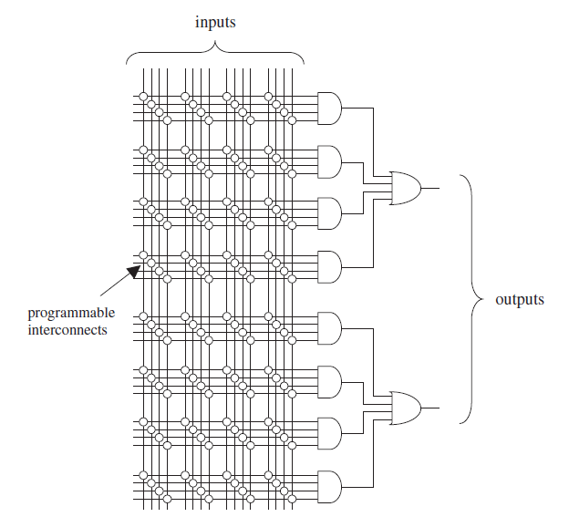
PAL Structure

Slide 45
PAL Structure (II)
A
B
C
D
P₁
P₂
O₁
P₃
P₄
P₅
O₂
P₆
Programmable AND array
Fixed
OR array

Slide 46
Realising Logic Functions with PALs
Procedure is to obtain minimal SOP expressions.
Example:
f_{a}(A,B,C,D) = A'.B'.D' + B'.C.D' + A'.B.C.D
f_{b}(A,B,C,D) = A'.B + B'.C.D'
f_{c}(A,B,C,D) = A'.B'.D' + B'.C'.D' + A'.B.C.D

Slide 47
Realising Logic Functions with PALs (II)
f_{a}(A,B,C,D) = A'.B'.D' + B'.C.D'
+ A'.B.C.D
f_{b}(A,B,C,D) = A'.B + B'.C.D'
f_{c}(A,B,C,D) = A'.B'.D' + B'.C'.D'
+ A'.B.C.D
PAL realisation of f_{a}, f_{ß} and f_{r}.
A
B
C
D
P₁
x
x
x
P₂
x
x
x
f_{α}
P₃
x
x
x
x
P₄
x
x
P₅
x
x
x
f_{β}
P₆
x
x
x
x
x
x
x
x
P₄
x
x
x
P₅
x
x
x
f_{χ}
P₆
x
x
x
x

Slide 48
Generic PAL (GAL)

Slide 49
GAL Devices
The GAL (Generic PAL) architecture was introduced by Lattice in the beginning of the 1980s.
Several important improvements over the first PAL devices:
A more sophisticated output cell (Macrocell) was constructed, which included, besides the flip-flop, several gates and multiplexers
The Macrocell itself was programmable, allowing several modes of operation
A ‘return’ signal from the output of the Macrocell to the programmable array was also included, conferring the circuit more versatility
EEPROM was employed instead of PROM or EPROM
GAL is the only SPLD still manufactured in a standalone package

Slide 50
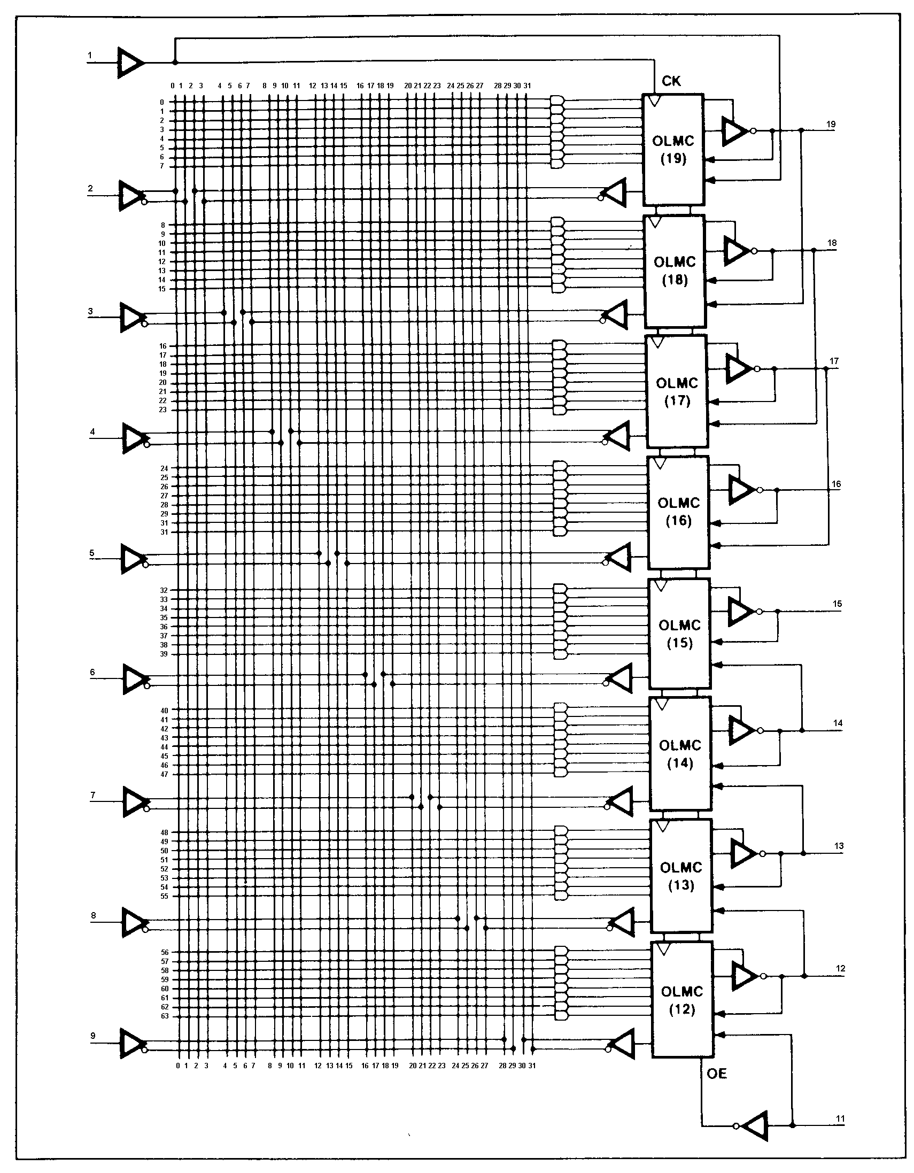
GAL Structure
OLMC (Output Logic MacroCell) has OR, FF, output multiplexer and I/O control logic.
Note that OLMC output is fed back to input matrix for use in other OLMCs.

Slide 51
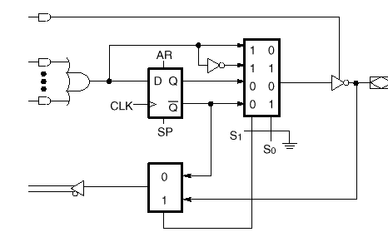
GAL22V10 OLMC Structure

Slide 52
Check Yourself
Implement the following circuit using GAL device

Slide 53
Complex PLD (CPLD)

Slide 54
CPLD (Complex PLD)
It consists of several PLDs (in general of GAL type) fabricated on a single chip, with a programmable switch matrix used to connect them together and to the I/O pins
CPLDs normally contain a few additional features, like JTAG support and interface to other logic standards (1.8 V, 2.5 V, 5 V, etc.).
A commercial sample: the Xilinx XC9500 CPLD
Companies manufacture CPLDs: Altera, Xilinx, Lattice, Atmel, Cypress, etc

Slide 55
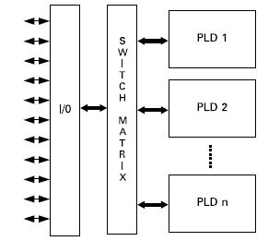
CPLD Architecture

Slide 56
Outline
Field Programmable Gate Array (FPGA)

Slide 57
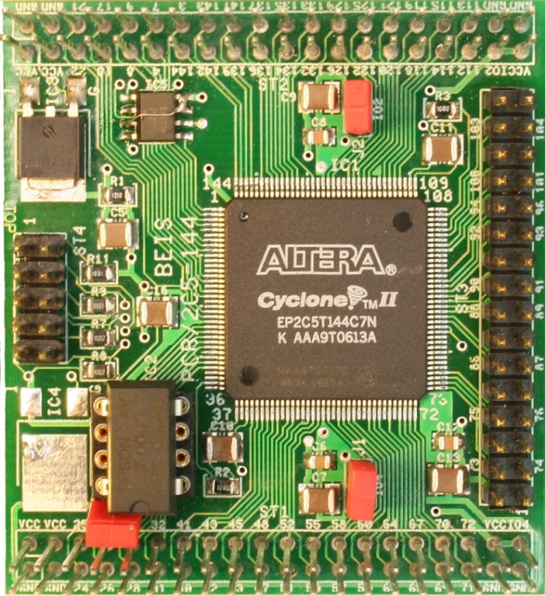
Field Programmable Gate Array

Slide 58
Field Programmable Gate Array
Field programmable Gate Arrays (FPGAs) are pre-fabricated silicon devices that can be electrically programmed in the field to become almost any kind of digital circuit or system.
The main advantage of FPGAs i.e. flexibility is also the major cause of its drawback
Flexible nature of FPGAs makes them significantly larger, slower, and more power consuming than their ASIC counterparts
These disadvantages arise largely because of the programmable routing interconnect of FPGAs which comprises of almost 90% of total area of FPGAs.

Slide 59
Field Programmable Gate Array (FPGA)
Field Programmable Gate Array (FPGA) devices were introduced by Xilinx in the mid 1980s
FPGA is a VLSI circuit that can be programmed in the user’s location.
A typical FPGA logic block consists of look-up tables, multiplexers, gates, and flip-flops.
Look-up table is a truth table stored in a SRAM and provides the combinational circuit functions for the logic block.
Companies manufacture FPGAs: Xilinx, Altera, Actel QuickLogic, Atmel, etc.

Slide 60
What's inside an FPGA?
Programmable logic blocks which implement logic functions
Programmable routing that connects these logic functions
I/O blocks that are connected to logic blocks through routing interconnect
Clock resources
Extremely high bandwidth RAM (10-100x more bandwidth than a PC)
Multiplexer
Lots of wires that can be connected in any fashion

Slide 61
Programming Technologies
Some of the well known programming technologies include
Static Memory (SRAM)
Flash memory
Anti-fuse

Slide 62
Programming Technologies (II)
Static memory
Most commercial vendors use static memory (SRAM) based
SRAM cells are mainly used for following purposes:
To program the routing interconnect of FPGAs which are generally steered by small multiplexors.
To program Configurable Logic Blocks (CLBs) that are used to implement logic functions
FPGA can be easily re-programmed
Main Drawback:
An SRAM cell requires 6 transistors which makes the use of this technology costly in terms of area
SRAM cells are volatile in nature and external devices are required to permanently store the configuration data

Slide 63
Programming Technologies (III)
Flash Programming Technology
It the use of flash or EEPROM (Electrically Erasable Programmable Read-Only Memory) based programming technology
This programming technology is nonvolatile in nature
More area efficient than SRAM-based programming technology
Drawbacks:
It can not be reconfigured/reprogrammed an infinite number of times
Flash-FPGA vs. EEPROM-FPGA
Flash uses NAND type memory while EEPROM uses NOR type.
Flash is block-wise erasable while EEPROM is byte-wise erasable
Flash has faster write cycles but slower erase cycles than EEPROM based FPGAs

Slide 64
Programming Technologies (IV)
Anti-fuse Programming Technology
It needs low area
This technology is non-volatile in nature
Drawbacks:
Anti-fuse programming technology based devices can not be reprogrammed
SRAM-based programming technology is the most widely used programming technology

Slide 65
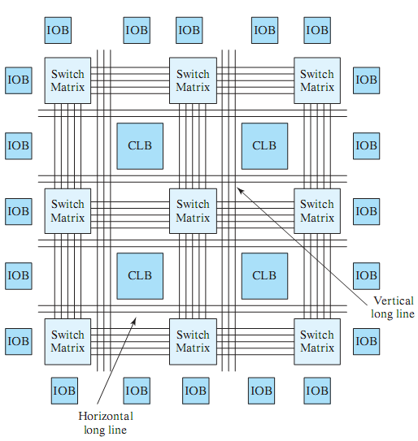
FPGA (II)
Xilinx FPGAs
Configurable Logic Block (CLB)
Programmable logic and FFs
Programmable Interconnects
Switch Matrices
Horizontal/vertical lines
I/O Block (IOB)
Programmable I/O pins

Slide 66
Configuration Logic Block (CLB)

Slide 67
Configuration Logic Block
A CLB can comprise of a single basic logic element (BLE), or a cluster of locally interconnected BLEs
A simple BLE consists of a LUT (Look Up Table), and a Flip-Flop.
A LUT with k inputs (LUT-k) contains 2^{k} configuration bits and it can implement any k-input Boolean function (2^2^k functions)

Slide 68
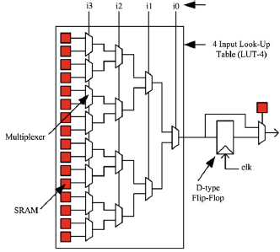
Basic logic element (BLE)

Slide 69
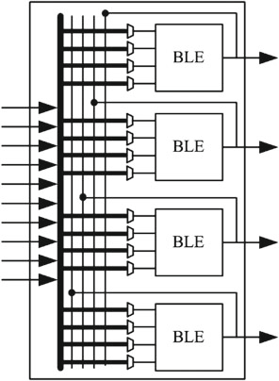
A CLB structure
Modern FPGAs contain typically 4 to 10 BLEs in a single CLB.

Slide 70
Interconnected Network

Slide 71
Interconnected Network (I)
CLBs are connect to each other through programmable routing network
This programmable routing network provides routing connections among logic blocks and I/O blocks to implement any user-defined circuit
It consists of wires and programmable switches that form the required connection.
These programmable switches are configured using the programmable technology.
Their routing interconnect must be very flexible to be able to implement any digital circuit
On the basis of the global arrangement of routing resources, the interconnected network can be categorized as either hierarchical or island-style

Slide 72
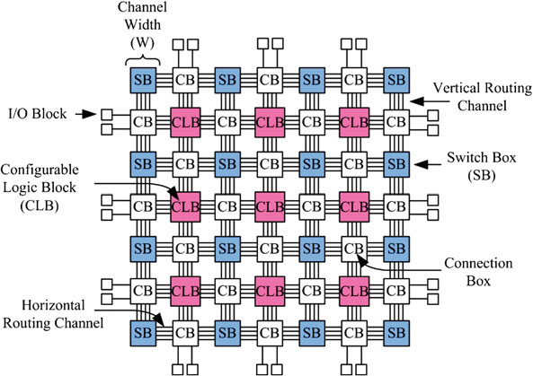
island-style FPGA architecture

Slide 73
island-style FPGA architecture (II)
The most commonly used architecture among academic and commercial FPGAs
It is called island-style architecture because in this architecture configurable logic blocks look like islands in a sea of routing interconnect.
(CLBs) are arranged on a 2D grid and are interconnected by a programmable routing network.
(I/O) blocks on the periphery of FPGA chip are also connected to the programmable routing network
programmable switches that are organized in horizontal and vertical routing channels.

Slide 74
Interconnected Network (III)
The routing network of an FPGA occupies 80–90% of total area, whereas the logic area occupies only 10–20% area
The flexibility of an FPGA is mainly dependent on its programmable routing network.
Horizontal and vertical routing tracks are interconnected through switch boxes (SB).
Logic blocks are connected to the routing network through connection boxes (CB)
The routing tracks connected through a switch box can be bidirectional or unidirectional

Slide 75
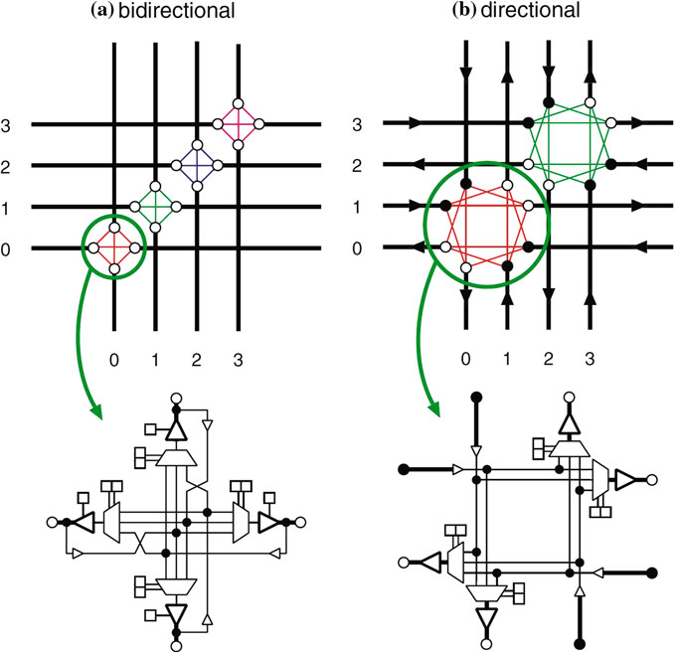
Interconnected Network (IV)

Slide 76
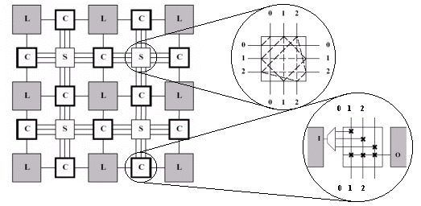
Switch Box (SB) vs. Connection Box (CB)

Slide 77
Hierarchical Routing Architecture
Most logic designs exhibit locality of connections; hence implying a hierarchy in placement and routing of connections between different logic blocks
Dividing FPGA logic blocks into separate groups/clusters
These clusters are recursively connected to form a hierarchical structure.
In a hierarchical architecture, connections between logic blocks within same cluster are made by wire segments at the lowest level of hierarchy
The connection between blocks residing in different groups require the traversal of one or more levels of hierarchy
In the hierarchical FPGA called HFPGA, LBs are grouped into clusters.

Slide 78
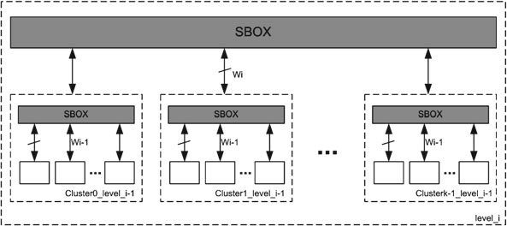
A Multi-level Hierarchical interconnect structure

Slide 79
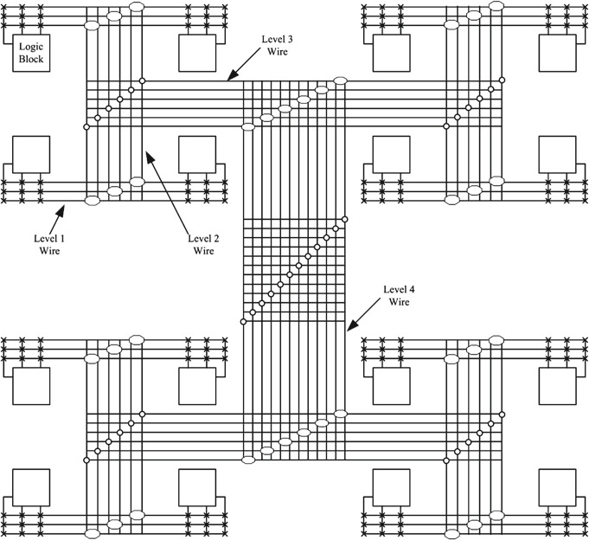
A tree-based Hierarchical interconnect structure

Slide 80
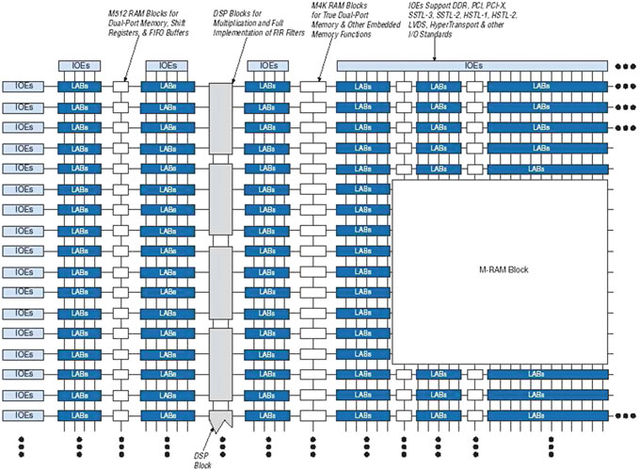
Altera’s Stratix II Architecture

Slide 81
Programming a Simple-Structured FPGA

Slide 82
FPGA structure

Slide 83
Simplified CLB Structure

Slide 84
Example 1: 4-input AND gate
A | B | C | D | O
0 | 0 | 0 | 0 | 0
0 | 0 | 0 | 1 | 0
0 | 0 | 1 | 0 | 0
0 | 0 | 1 | 1 | 0
0 | 1 | 0 | 0 | 0
0 | 1 | 0 | 1 | 0
0 | 1 | 1 | 0 | 0
0 | 1 | 1 | 1 | 0
1 | 0 | 0 | 0 | 0
1 | 0 | 0 | 1 | 0
1 | 0 | 1 | 0 | 0
1 | 0 | 1 | 1 | 0
1 | 1 | 0 | 0 | 0
1 | 1 | 0 | 1 | 0
1 | 1 | 1 | 0 | 0
1 | 1 | 1 | 1 | 1

Slide 85
Example 2: Find the configuration bits for the following circuit
A0 | A1 | S
0 | 0 | 0
0 | 0 | 1
0 | 1 | 0
0 | 1 | 1
1 | 0 | 0
1 | 0 | 1
1 | 1 | 0
1 | 1 | 1

Slide 86
Interconnection Network

Slide 87
Example 3
Determine the configuration bits for the following circuit implementation in a 2x2 FPGA, with I/O constraints as shown in the following figure. Assume 2-input LUTs in each CLB.

Slide 88
CLBs required

Slide 89
Placement: Select CLBs

Slide 90
Routing: Select path

Slide 91
Configuration Bitstream
The configuration bitstream must include ALL CLBs and SBs, even unused ones
CLB0: 00011
CLB1: XXXXX
CLB2: 01100
CLB3: XXXXX
SB0: 000000
SB1: 000010
SB2: 000000
SB3: 000000
SB4: 000001

Slide 92
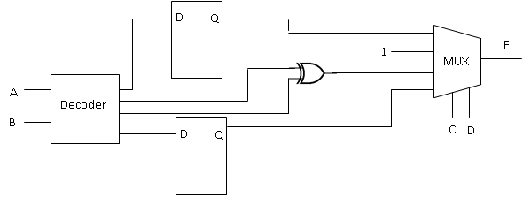
Exam Question
Configure a Xilinx FPGA for the following digital circuit. Show the configuration bits for all cells and switch boxes.

Slide 93
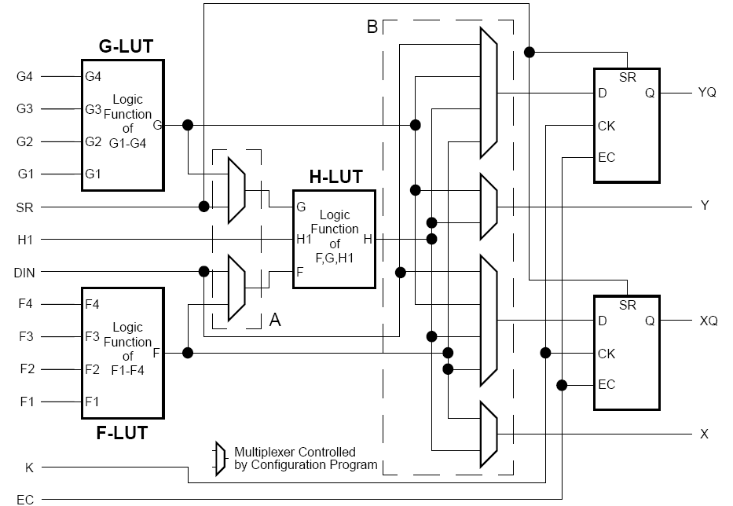
Realistic FPGA CLB: Xilinx

Slide 94
How is an FPGA programmed?
Write a program in HDL (VHDL, Verilog, schematics)
Simulate
Synthesis
Place and route
Timing – maximum clock-rate is determined by tools
Resulting .bin file to be programmed into the FPGA

Slide 95
Outline
I/O components
Modern FPGAs

Slide 96
Programmable I/O

Slide 97
I/O components allow for the communication of a design inside the FPGA with off-chip modules
FPGA I/Os are programmable
To configure a single interface pin as input, output or bidirectional.
See next slide to see the general structure of an I/O component:

Slide 98
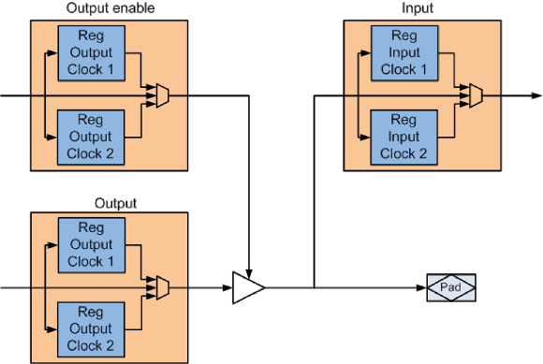
General structure of an I/O component
Clock1 is used for rising edge clock
Clock2 is used for falling edge clock

Slide 99
I/O Structure
Single Data Rate (SDR)
Data are copied into the I/O registers on the rising clock edge only
Double Data Rate (DDR)
Exploits the falling clock edge and the rising clock edge to copy data into the I/O registers
The double data rate is directly accomplished by the two registers on each path

Slide 100
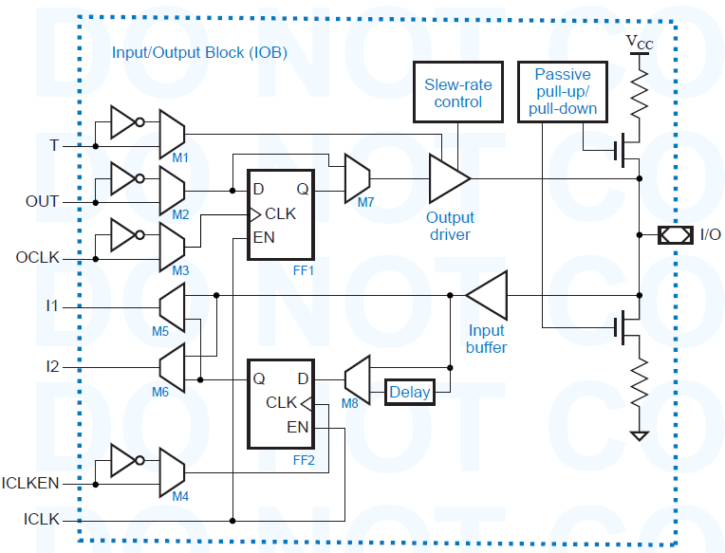
The structure of the XC4000 I/O block (IOB)

Slide 101
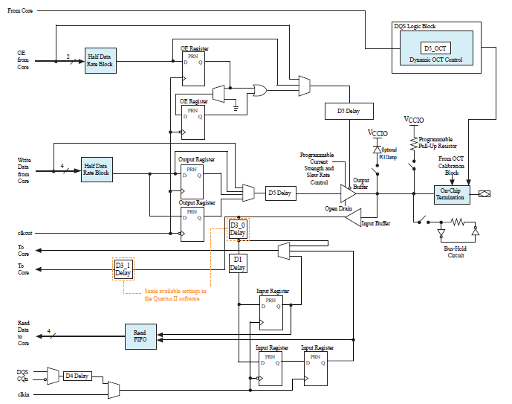
IOE Structure for Cyclone V Devices

Slide 102
Modern FPGAs

Slide 103
Every two/three years, Xilinx produces new FPGA devices
The architecture principle of all devices is similar.
Modern FPGAs of Intel
Cyclone
Modern FPGAs of Xilinx
Artix

Slide 104
Introducing Cyclone Devices
Low power
200K LE for under 0.25 Watt (cyclone III)
300K LE for cyclone V
TSMC 60-nm process (cyclone III)
TSMC 20-nm process for cyclone V
Quartus II software power-aware design flow
High functionality
Up to 8 Mbits of embedded memory (cyclone III)
12 Mbits of embedded memory (cyclone V)
Up to 396 embedded multipliers (cyclone III)
Up to 2000 embedded multipliers (cyclone V)
Type of multipliers
9x9, 18x18, 27x27

Slide 105
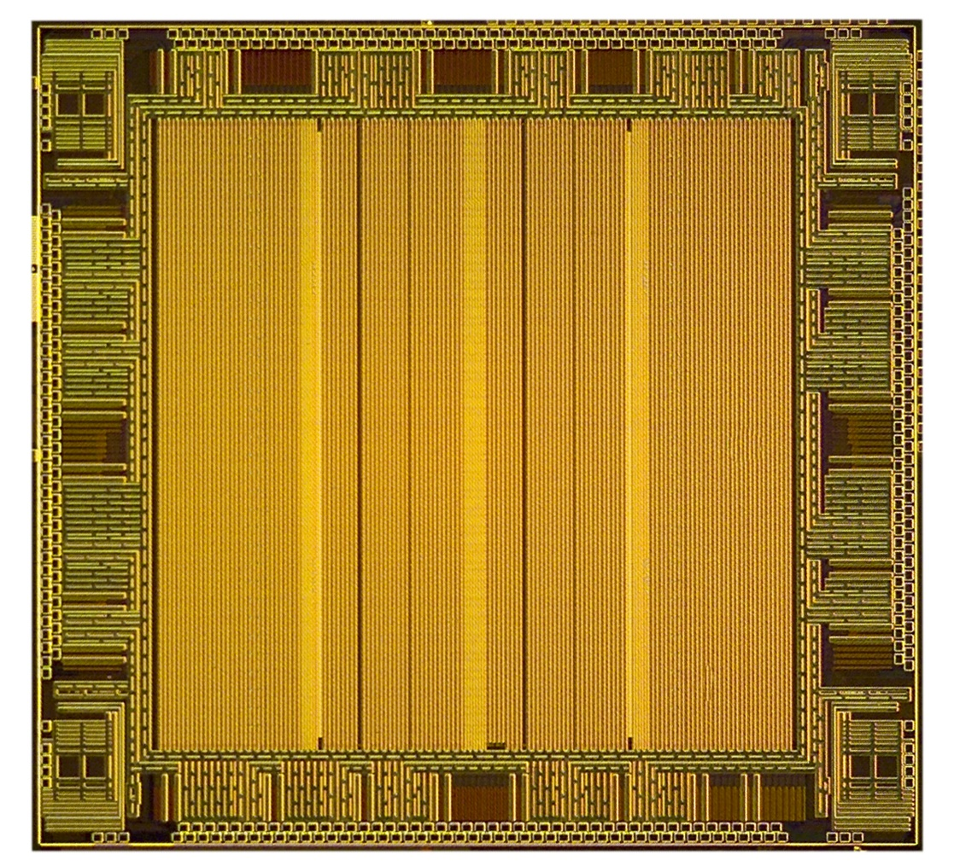
Cyclone III Key Architectural Features
70 – 198K logic elements at 402 MHz
Up to 8-Mbit memory
Up to 396 multipliers for DSP
Anti-tamper and design security
Staggered I/O ring, up to 413 user I/Os
333-Mbps DDR2 interface
Dynamically configurable PLLs and 20 global clocks
640-Mbps LVDS interface
PLL: phase locked loop: a control system that generates an output signal whose phase is related to the phase of an input signal. important module for clock management.
Anti-tamper: Deter reverse engineering
LVDS (low-voltage differential signaling) is a high-speed, long-distance digital interface for serial communication
Notes:
This slide shows the key features of the Cyclone III LS architecture and is a blueprint for the features that will be highlighted in the separate “technical” presentation. Starting from the top and moving down:
The core voltage is 1.2V but since we are using a 60-nm low power process, this family is able to offer very low static power.
The logic density is the largest of any low power FPGA family in the market, up to 198K high speed logic elements.
The highest density device contains 8.2 Mbits of RAM, divided into 9K blocks that were optimized for video buffering and other RAM intensive applications. This 8.2 Mbits of RAM is made up of 891 individual blocks that can be configured as single port, dual port, or true dual port RAM or ROM.
There are up to 396 18x18 multipliers which can be used for parallel processing of image or data…for example if you needed to support the latest generation of codecs like H.264.
The devices support both parallel and serial configuration and offer a feature that eliminates the need for an external microcontroller if you wish to do remote system upgrades.
The PLLs are dynamically reconfigurable in system, and feature up to 5 outputs per PLL. Each device has 4 PLLs.
There is a good supply of global clocks on all of the density members in the family and each individual global clock can be statically or dynamically turned off to lower power consumption for any unused logic.

Slide 106
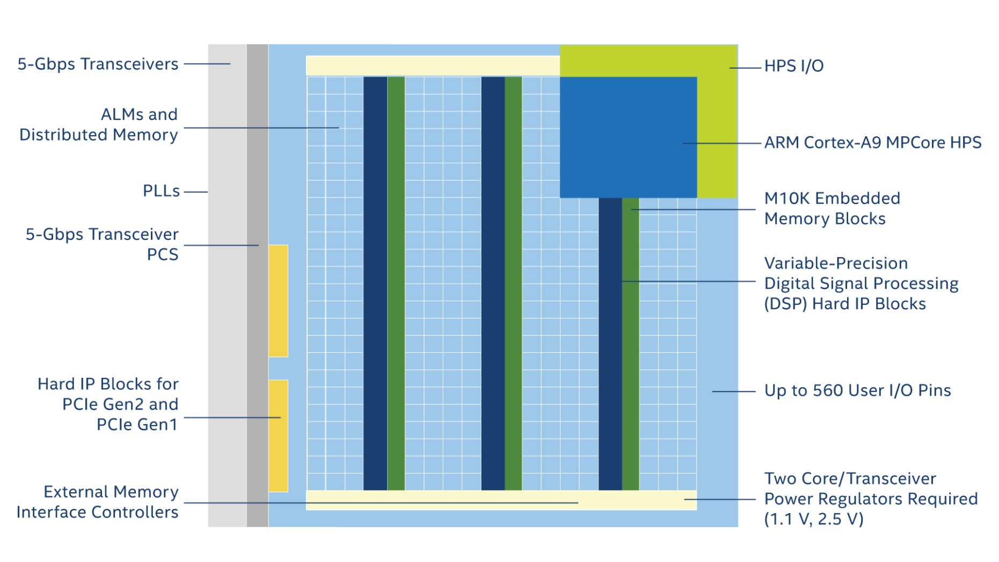
Cyclone V Key Architectural Features
ALM: Adaptive logic module
HPS: high performance storage
A transceiver is a combination transmitter/receiver in a single package.
PCIe: PCI express peripheral

Slide 107
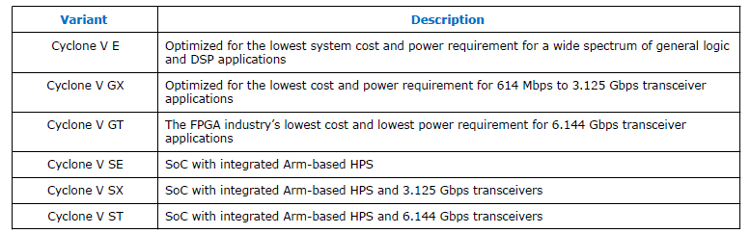
Device Variants for the Cyclone V Device Family

Slide 108

Adaptive logic module

Slide 109
Memory in cyclone
M10K blocks: Each block has 10kbit memory
Cyclone V has 120 to 1200 blocks
RAM blocks either are single port or dual port
MLAB blocks: some LABS are configured to be blocks of RAMs.
Each LAB becomes 640 bit dual-port RAM
They can be used to implement buffers and FIFOs

Slide 110

M10k memory block configuration

Slide 111

DSP block in Cyclone V
various multiplication operations are supported
Single 27x27
Two operations of 18x19
Three operations of 9x9
Includes integer, fixed-point and floating point multiplications
Addition, subtraction and accumulation
∑(Xi×Yi)
Save coefficients in a register bank to implement a Filter
Y[n] = ∑CiX[n-i]

Slide 112

DSP block in cyclone V

Slide 113

Hardcore processor in cyclone V
Two ARM core processors

Slide 114
Xilinx Artix-7 architecture

Slide 115

The Xilinx Configurable Logic Block
The basic computing block consists of
An LUT with variable number of inputs,
Task: Store the configuration
A set of multiplexers,
Task: Select the right inputs for the LUT and the storage element as well as the right output of the block
Arithmetic logic
Task: provides some facilities such as XOR-gate and faster carry chain to build faster adder
A storage element (DFF)

Slide 116

CLB in xlinx
A configurable logic block (CLB) is a basic block used to implement the logic
Each CLB contains two Logic Slices

Slide 117
Artix-7
The Artix-7 (Artix-7 7A200T) has a total of 33,650 logic slices (16,825 CLBs)
Each logic slice contains four 6-input LUTs and eight flip-flops.
This corresponds to 134,600 total 6-input LUTs.

Slide 118

A diagram of a SLICE in Artix7

Slide 119

Interconnect in Artix7

Slide 120

LUT-6 is used as two LUT-5s

Slide 121

DSP Slice in Artix7

